Slide 1
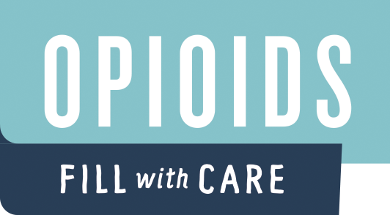
North Dakota
Opioid Overdose Response Training

Slide 2
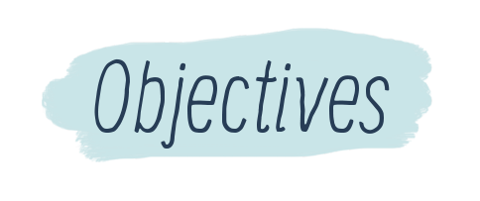
By the end of this training, participants will:
Identify what puts a person at higher risk for an overdose
Know how to recognize an overdose
Know how to effectively respond to an overdose, including the administration of Narcan® Nasal Spray
Be familiar with the relevant North Dakota laws permitting individual use of naloxone
Know how to access naloxone and other overdose prevention resources

Slide 4
Notes:
overdose deaths in the state decreased for the first time since a record 77 deaths were reported in 2016.
According to the CDC, drug overdose deaths in North Dakota fell by 13.2 percent to 68 deaths in 2017.

Slide 5
Local Opioid Statistics
COMMUNITY ADD INFORMATION OR DELETE SLIDE

Slide 7
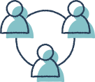
Who is at highest risk?
Anyone who uses prescription opioids or illegal opioids are at risk for an overdose.
Notes:
Increased risk factors include…

Slide 8
Who is at highest risk?
Anyone who:
Accidentally or deliberately takes an extra dose or misuses a prescription opioid
Receives more than one opioid medication prescription
Takes opioid medications prescribed for someone else
Injects or snorts opioids
Notes:
Increased risk factors include…

Slide 9
Who is at highest risk?
Anyone who:
Combines opioids – prescribed or illicit – with alcohol, certain other medications
Even some over-the-counter products that depress breathing, heart rate, and other functions of the central nervous systems
Is prescribed opioids with a history of addiction
Has an opioid use disorder and has been recently released from detoxification, incarceration, or treatment
Notes:
Increased risk factors include…

Slide 11
Signs of Overdose
All opioids can depress the central nervous system if too much is taken. This results in decreased or cessation of breathing effort. Left untreated, this can lead to death.
An opioid overdose requires immediate medical attention.
Recognizing the signs of opioid overdose is essential to save a life.

Slide 12
Signs of Overdose
Call 911 immediately if a person exhibits any of these symptoms:
Face is clammy to touch and has lost color
Body is limp
Fingernails or lips have a blue or purple tinge
Vomiting or making gurgling noises
Cannot be awakened from sleep or unable to speak
Breathing is slow or has stopped
Heartbeat is slow or has stopped

Slide 13
Overdose Progression
Ingestion of excess opioid
Breathing effort slows
Slowing of breathing deprives brain, heart, and body of oxygen
Irreversible damage occurs to brain and other organs
Loss of consciousness
Death
Cardiac arrest occurs

Slide 15
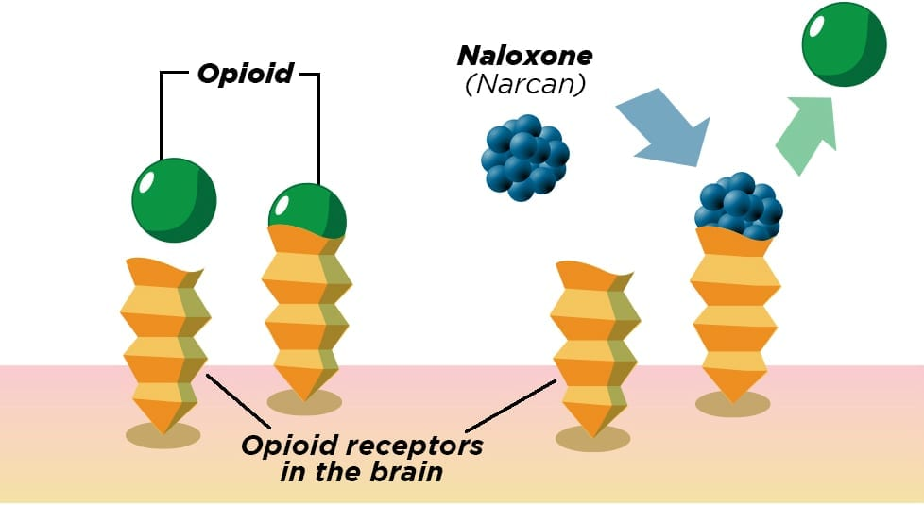
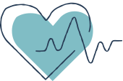
Naloxone is an antidote to overdose of heroin or other opioid drugs. It works by blocking the effects of opioids in a person’s system, helping to restore breathing.
Individuals need medical follow-up after administration of naloxone.
Notes:
The opioid is an agonist – it fits into or activates the opioid receptors in the brain allowing a full opioid affect.
Narcan is an antagonist – it acts like glue in a lock or a broken key in the lock of the receptor, blocking the agonist from activating the receptors in the brain. The receptors have a great affinity for Narcan, which is why Narcan can not only block but reverse an overdose. However, Narcan only works for a short time, generally only 30-90 minutes, but the effects of the opioid can last for hours – so they may need an additional dose of Narcan. This is why it is best to transfer to a hospital for observation.

Slide 16
Naloxone is EFFECTIVE when the overdose is due to usage of an OPIOID
Heroin
Naloxone will have
NO EFFECT when overdose is due to usage of:
Alcohol
Morphine
Hydromorphone (Dilaudid)
Oxycodone (Oxycontin, Percocet)
Hydrocodone (Norco, Vicodin)
Fentanyl
Buprenorphine
Codeine
Methadone
Benzodiazepines (Valium, Ativan, Xanax, Klonopin,)
Other medications
Antidepressants (Paxil, Prozac, Lexapro, Wellbutrin)
Tramadol
Other illicit drugs such as methamphetamine
Although you may not know what the overdose is from, it may be beneficial to administer naloxone. If opioids have been taken with a combination of other drugs the naloxone will negate the opioid effects and could save a life.

Slide 17
Naloxone Safety
Not a substitute for emergency care
May initiate opioid withdrawal
Do not give if there is a known hypersensitivity to naloxone (extremely rare)
Naloxone does not produce tolerance to opioids
Avoid multiple, rapid doses and implement rescue breathing to prevent Opioid Overdose Associated Non-Cardiogenic Pulmonary Edema
One dose every 2-3 minutes until breathing effort returns

Slide 18
Naloxone Safety
Research has shown that access to naloxone does not increase drug use.
Limiting access to naloxone only prevents someone from receiving an effective emergency life-saving measure.

Slide 19
Three FDA-Approved Formulations of Naloxone:
NARCAN ® Nasal Spray
EVZIO ® Auto-Injector
Injectable
(professional training required)
NARCAN® Nasal Spray is a prefilled, needle-free device that requires no assembly, which can deliver a single dose into one nostril while the patient lies on their back.
EVZIO ® Auto-Injector is injected into the outer thigh to deliver naloxone to the muscle (intramuscular). Once turned on, the device provides verbal instruction to the user describing how to deliver the medication, similar to automated defibrillators.
Naloxone injection comes as a liquid solution to be injected into a vein (intravenous), into the muscle (intramuscular) or under the skin (subcutaneous). It is also available as a prefilled syringe for injection into the vein or to spray into the nose with an atomizer (intranasal).

Slide 20
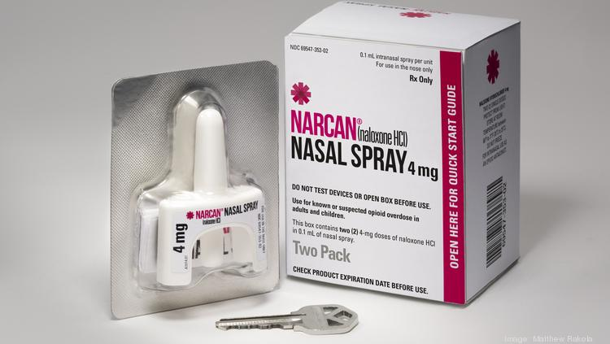

Slide 21
NARCAN® Medication Storage
Naloxone should be kept at room temperature– between 59º and 77º.
Do not let it freeze in your car
Protect from light
The naloxone shelf life is 2 years
Studies have shown that Narcan can be used for up to 5+ years past the expiration date; however, the FDA recommends disposal at expiration date*.
Expired or previously frozen naloxone retains most of its potency.
Keep away from children.

Slide 23
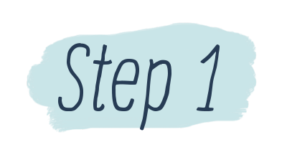
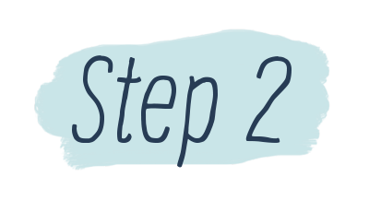
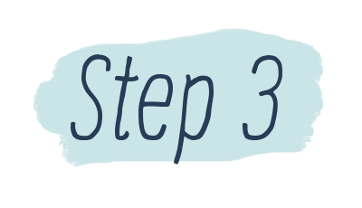
Call 911 and begin rescue breaths
Responding to an Overdose
Administer naloxone and continue rescue breaths
Stay on scene until first responders arrive

Slide 24
Assess surroundings for your safety
Attempt to wake the person
Ask person if he or she is okay and shout name
Shake shoulders and/or firmly rub the middle of their chest
Check for signs of an opioid overdose
Will not wake up or respond to your voice or touch
Breathing is very slow, irregular, or has stopped
Center part of their eye is very small, sometimes called “pinpoint pupils”
Check for a pulse, if no pulse, do CPR
Call 911
The effect of naloxone is temporary. Once naloxone wears off, the person may return to an overdose state and is at risk for death. An overdose always requires immediate medical attention.
Call 911 and begin rescue breaths

Slide 25
Put on gloves if available
Provide 2 rescue breaths using mask or rescue breathing aid if available
One hand on chin, tilt head back, pinch nose closed
Make seal over mouth, breathe into mouth
1 breath every 5 seconds
Chest should rise, not stomach (if stomach rises, readjust)
Call 911 and begin rescue breaths

Slide 26
Lay the person on their back to receive a dose of NARCAN Nasal Spray
Remove NARCAN Nasal Spray from the box. Peel back the tab with the circle to open the NARCAN Nasal Spray.
Hold the NARCAN Nasal Spray with your thumb on the bottom of the plunger and your first and middle fingers on either side of the nozzle.
Gently insert the tip of the nozzle into either nostril. Tilt the person’s head back and provide support under the neck with your hand. Gently insert the tip of the nozzle into one nostril, until your fingers on either side of the nozzle are against the bottom of the person’s nose.
Press the plunger firmly to give the dose of NARCAN Nasal Spray. Remove the NARCAN Nasal Spray from the nostril after giving the dose.
Continue rescue breaths until breathing effort returns
Administer Naloxone & Continue Rescue Breaths

Slide 27
Move the person on their side (recovery position) after giving NARCAN Nasal Spray.
Watch the person closely.
If the person does not respond by waking up, to voice or touch, or breathing normally another dose may be given.
NARCAN Nasal Spray may be administered every 2 to 3 minutes, if available.
Administer Naloxone & Continue Rescue Breaths

Slide 28
When naloxone is used, the person will likely develop symptoms such as nausea, vomiting, diarrhea, sweating, body aches, weakness, and shortness of breath.
These are symptoms of withdrawal from the opioid and are expected
Withdrawal symptoms will not cause harm
A person can have different behaviors and emotions upon waking up from an opioid overdose:
Confused
Agitated
Sedation (with return of breathing effort)
Anger
Embarrassment
Frustration
Sadness
Stay on Scene Until First Responders Arrive

Slide 29
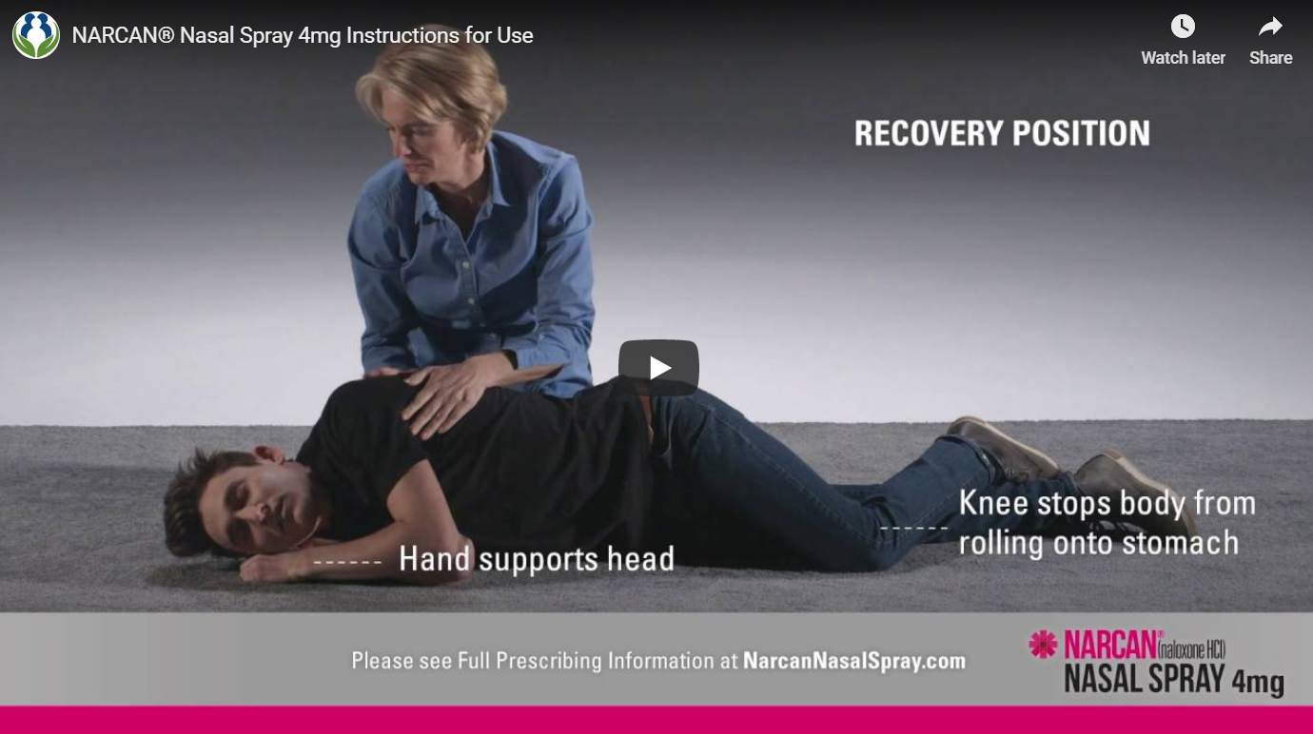
Instructions for Using NARCAN® Nasal Spray 4mg

Slide 30
SUMMARY: Overdose Response
Recognize a potential opioid overdose
Notify medical responders of possible overdose
Administer naloxone (Narcan Nasal Spray)
Rescue breathing (1 breath every 5 seconds)
Place in recovery position (If breathing effort returns or you must leave the victim)
Provide care until first responders arrive
Inform first responders of interventions
Check for pulse, if no pulse, begin rescue breathing (CPR)
Repeat in 2-3 minutes if breathing effort does not return

Slide 31
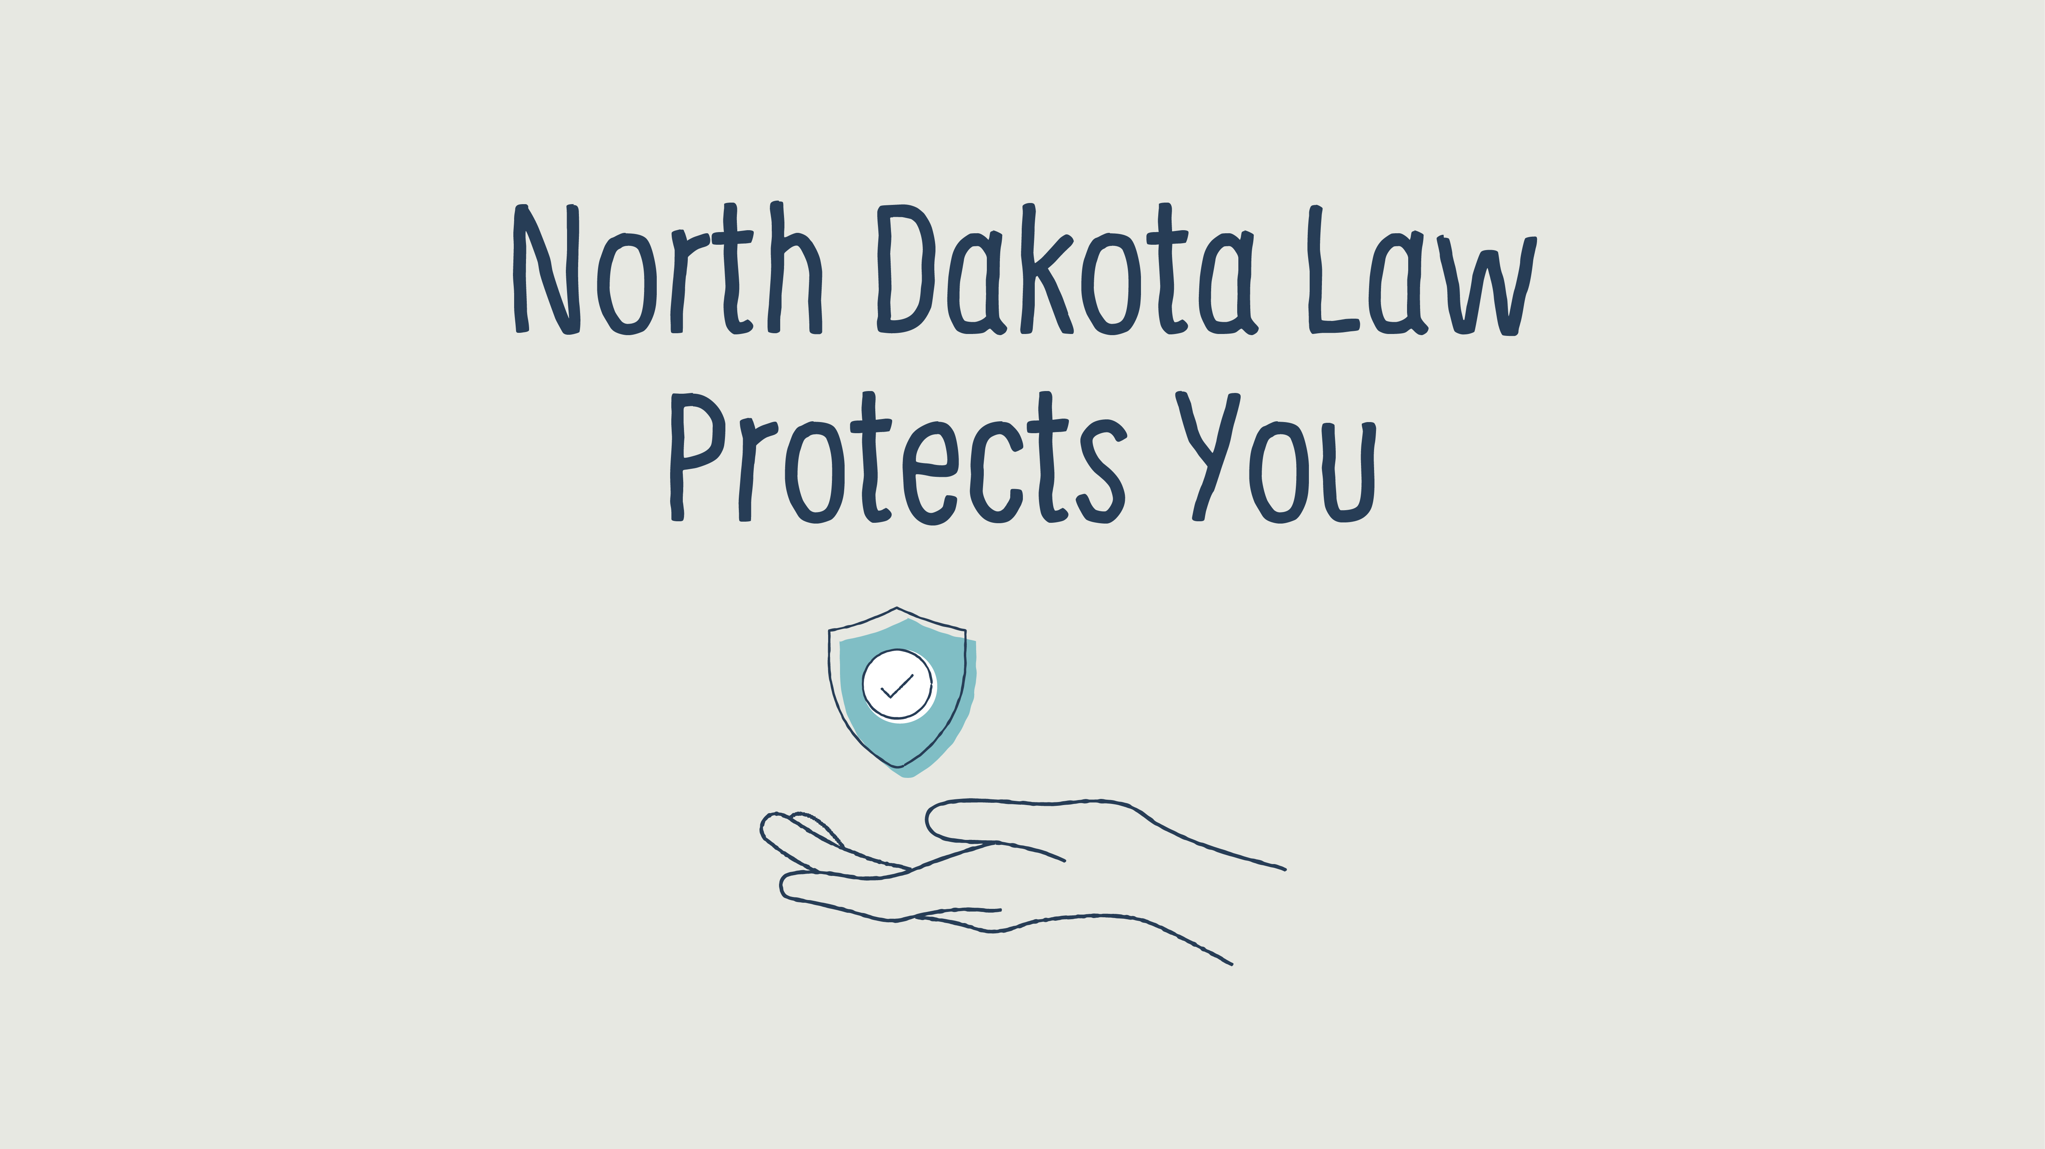

Slide 32
The ND Good Samaritan Law was passed to encourage friends, family members, and bystanders to call 911 in the event of an overdose.
In order to be immune from prosecution, you need to:
Call 911
Remain onsite until assistance arrives
Cooperate with law enforcement and emergency medical service personnel
North Dakota Century Code 19-03.1-23.4

Slide 33
According to North Dakota law, any individual (family, friends, or community member) is protected from civil or criminal liability for giving naloxone for a suspected opioid overdose. North Dakota Century Code 23-01-42

Slide 34
NOW, THEREFORE, Doug Burgum, Governor of North Dakota, by virtue of the authority granted under Article V, Section 1 of the North Dakota Constitution, North Dakota Century Code § 37-17.1 hereby direct that all cabinet agencies collaborate with local and tribal governments and law enforcement to make naloxone readily accessible to first responders, individual opioid users and their family members and to community leaders.
Executive Order 2016-17

Slide 36
Naloxone availability
Anyone at risk for having or witnessing an opioid overdose can obtain a prescription. (North Dakota Century code 23-01-42)
A physician or local pharmacists can write a prescription to anyone for naloxone.
Notes:
Increased risk factors include…

Slide 37
